Slide 1
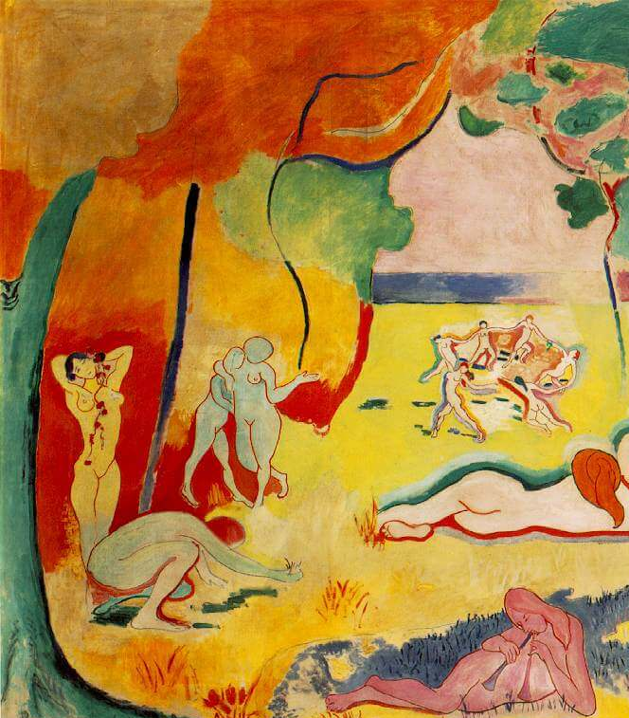
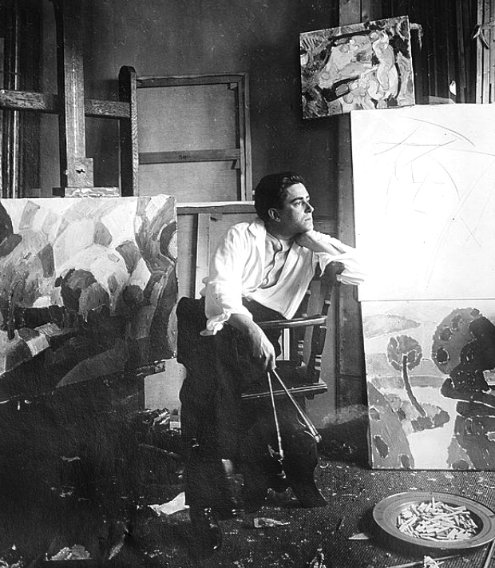
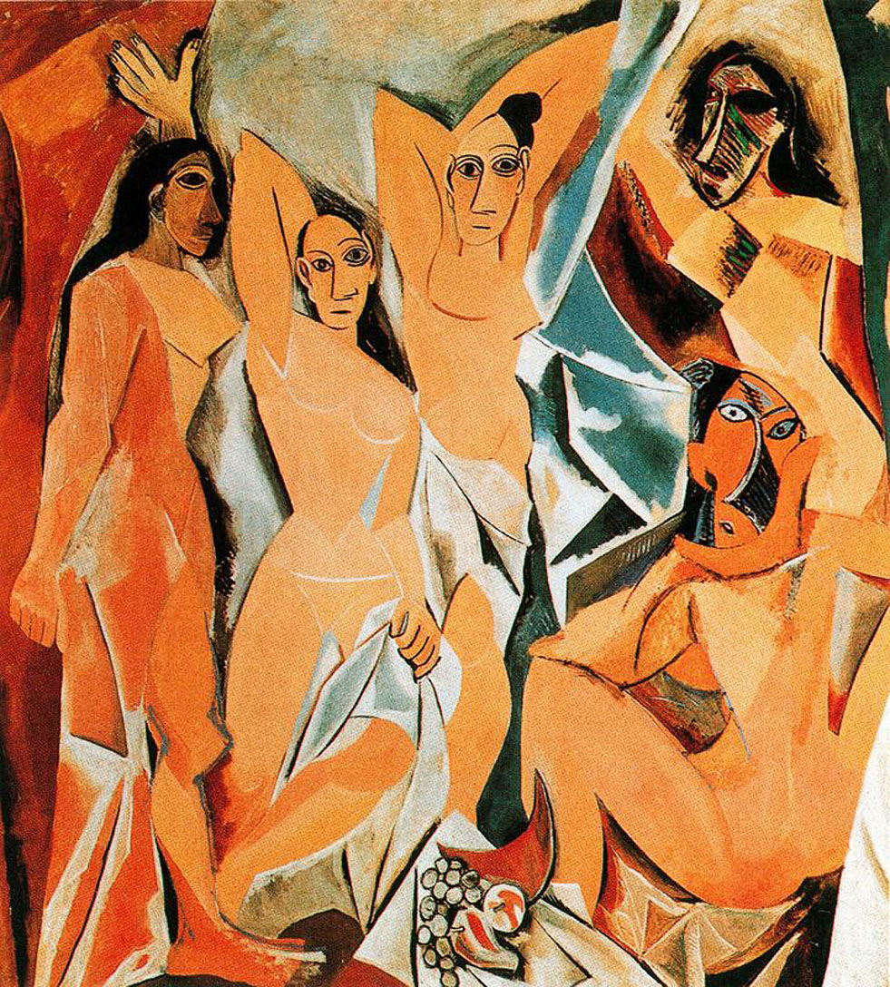
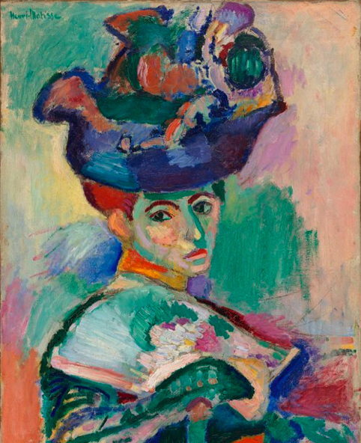
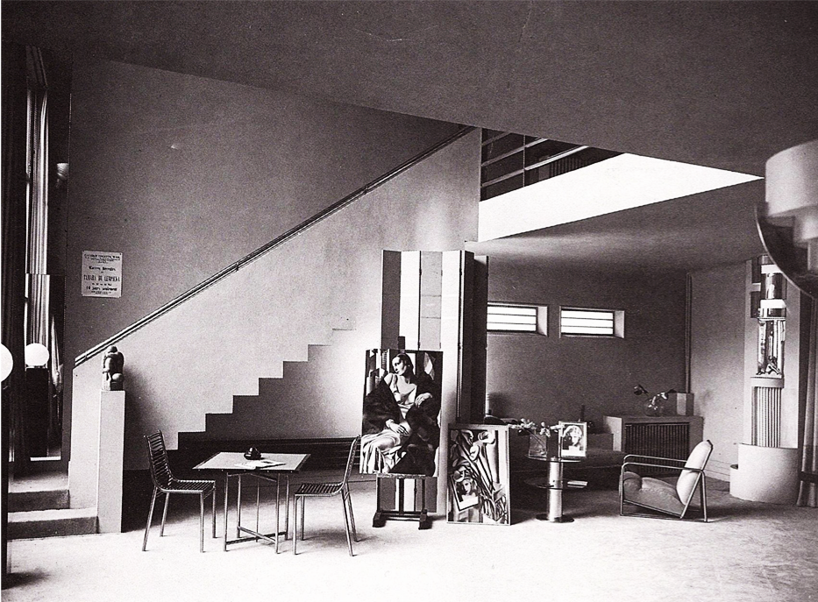
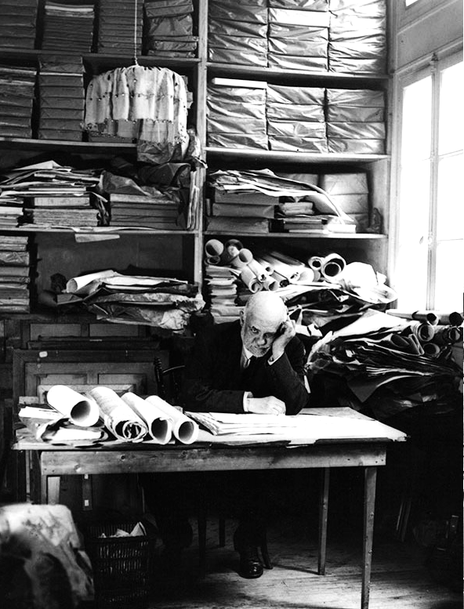
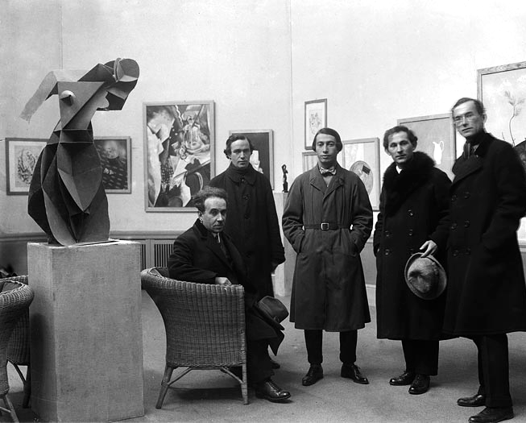
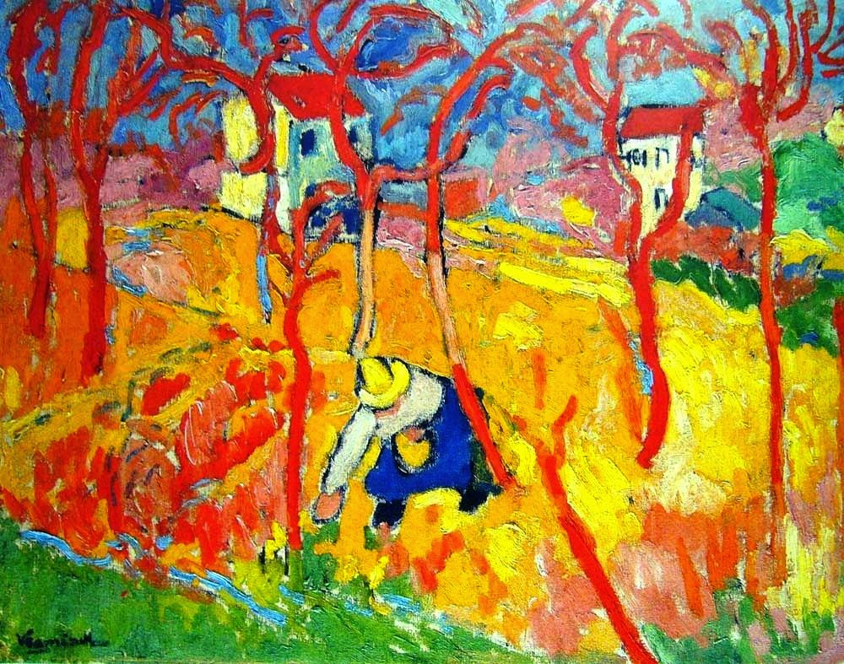
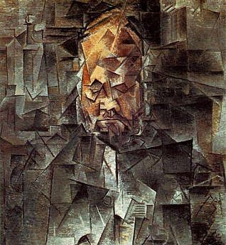
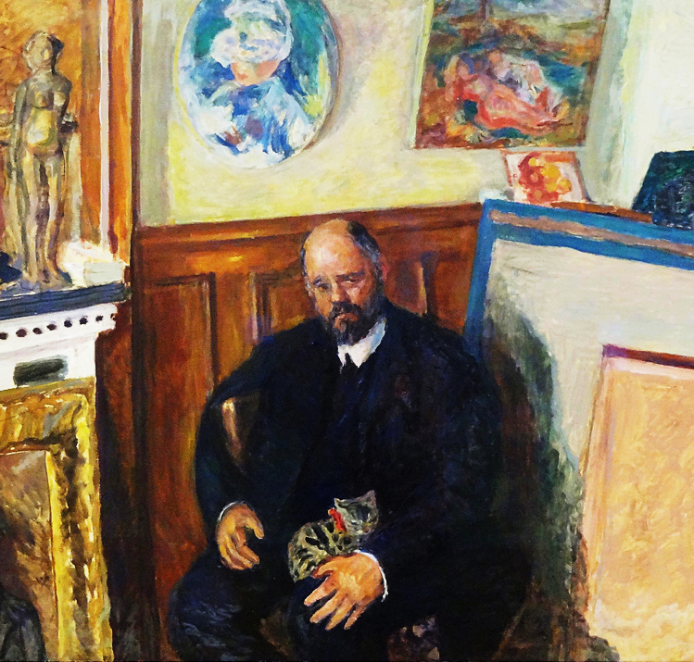
EXPLAINING THE MODERN:
How to Sell a Painting in Avant Garde Paris
Avant-garde artists in the early years of the twentieth century strove to find a new vocabulary for art and a new way forward. Artists such as Matisse, Braque, Vlaminck and Picasso produced works which were not only ground-breaking but shockingly innovative. The resulting break-throughs, though, were often incomprehensible even to the most ardent of supporters.
How, then, could artists explain their new approaches and convince collectors and the public to appreciate what they were doing? How could they sell paintings of such extraordinary modernity?
The task involved a variety of complex options. Which dealer to choose, what terms to negotiate, and where to exhibit? Was time best spent attending the salons of collectors such as Gertrude Stein and Peggy Guggenheim, hobnobbing with Bohemian society, or stealing a march on their fellow artists in the race for new ideas? Taking the period 1900-1939, examining the paintings and the ideas behind them, this lecture reveals the struggle of artists to elicit an interest in works which now sell for millions.
Dr Claire Walsh clairewalshlecturer@gmail.com 01480 830 760 www.clairewalsh.moonfruit.com

