Slide 1
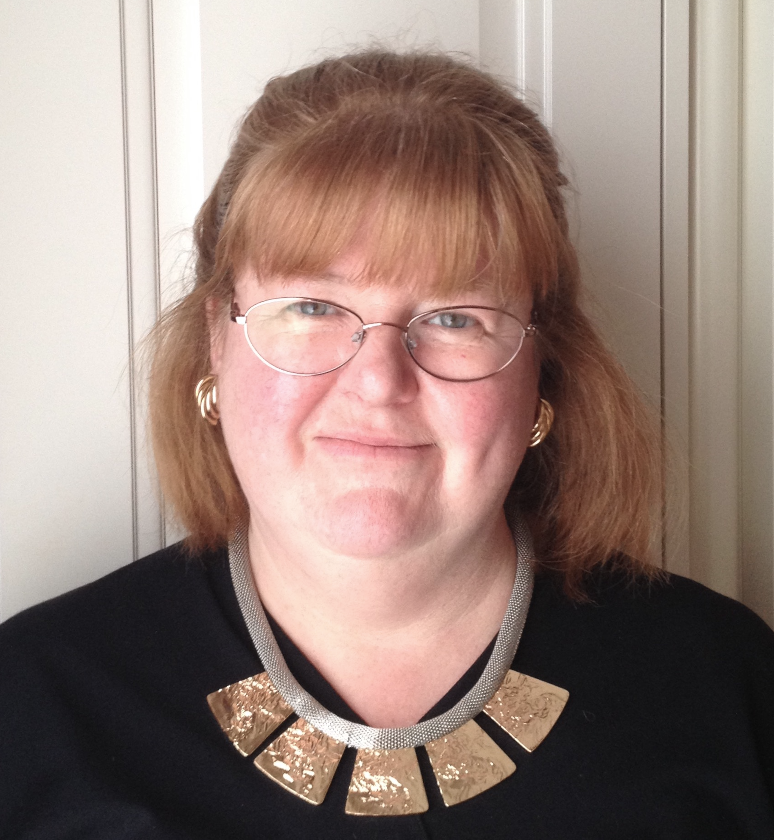
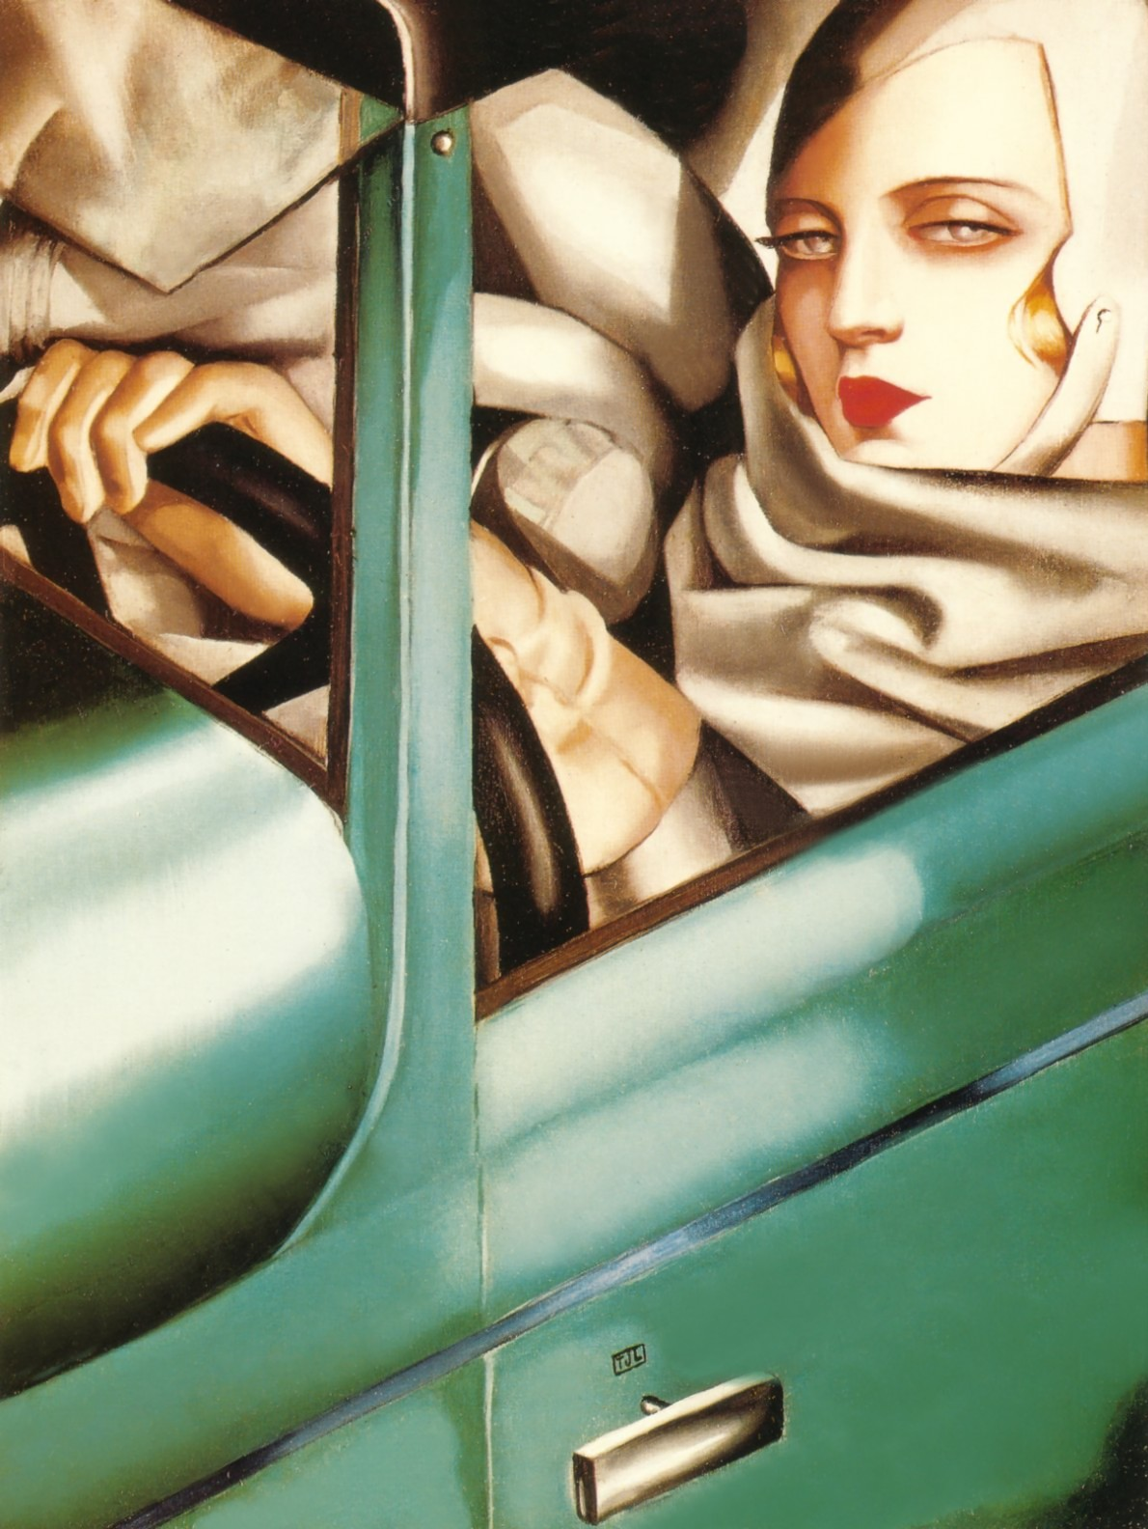
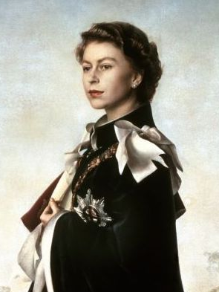
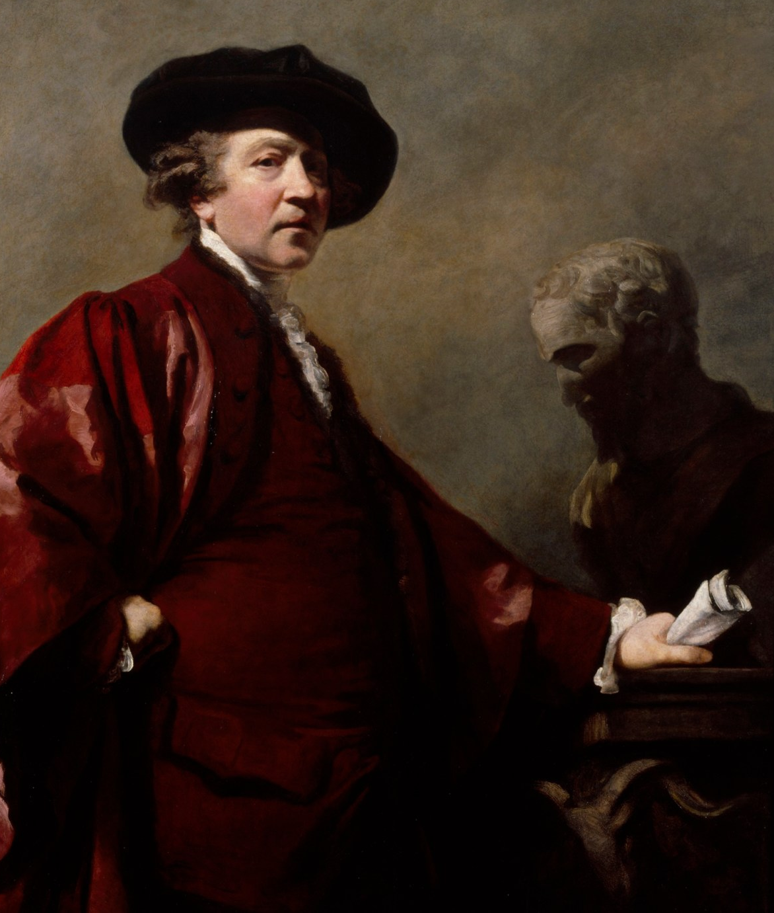
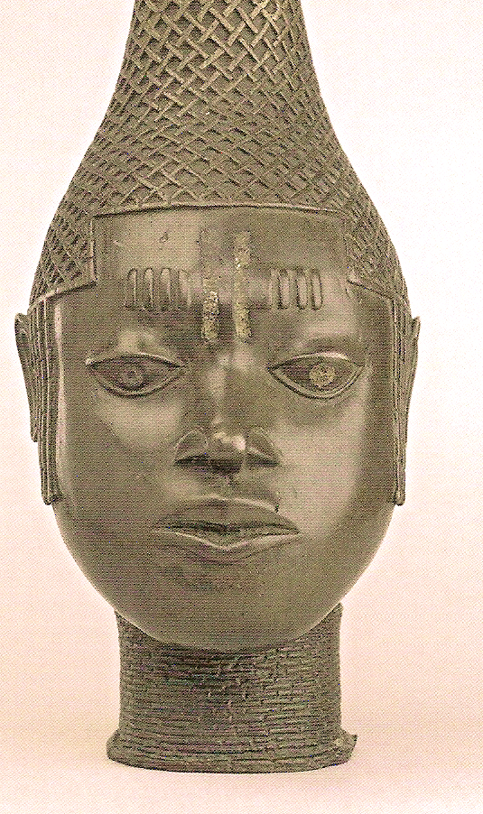
.
Dr Claire Walsh
Lecture List (Digital)
1. Power and Propaganda: Painting Royalty from
Charles I to Elizabeth II
2. Artists and the Creation of Celebrity Culture
3. Explaining the Modern: How to Sell a
Painting in Avant Garde Paris
4. Allan Ramsay: Scotland’s 18C Portrait Innovator
5. Tamara de Lempicka: Mistress of Art Deco
6. Winston Churchill, the Artist
7. Powder and Poison: Cosmetics, Beauty and the
Art of Portraiture
8. The Benin Bronzes: Masterpieces of African Art
9. Wimples to Wellingtons: A History of Dress and
Fashion
10. The Well-Dressed Gentleman: Male Sartorial
Elegance, 17C-20C
Christmas Lectures:
11. The Christmas Tree: From Forest Fir to Festive
Feature
12. Jane Austen’s Christmas: The Festive Season in the
Georgian Era
Tel: 01480 830 760 clairewalshlecturer@gmail.com
The Cottage, Potton Rd, Hilton, Cambs, PE28 9NG
For full details see: www.clairewalsh.moonfruit.com
BA Hons. History and Theory of Art, University of Kent
MA History of Design, Victoria & Albert Museum/ RCA
PhD History, The European University Institute, Florence
Having worked at the Victoria & Albert Museum and lectured for the University of Warwick, I now teach at the Open University. I have lectured widely in Britain (at the Courtauld Institute of Art, Victoria & Albert Museum, Costume Society and Museum of London amongst others), and in Europe, the USA and Canada. I am based near Cambridge, and am willing to travel.

