Slide 1
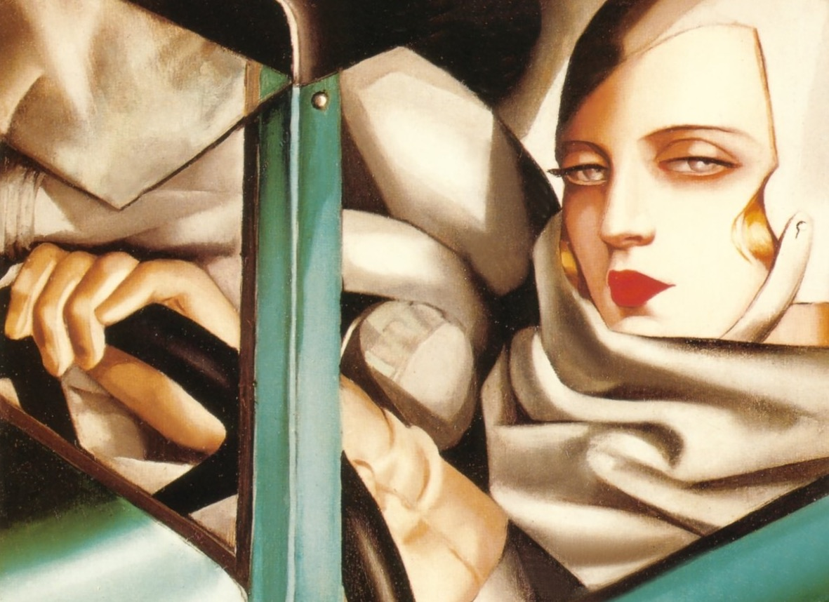
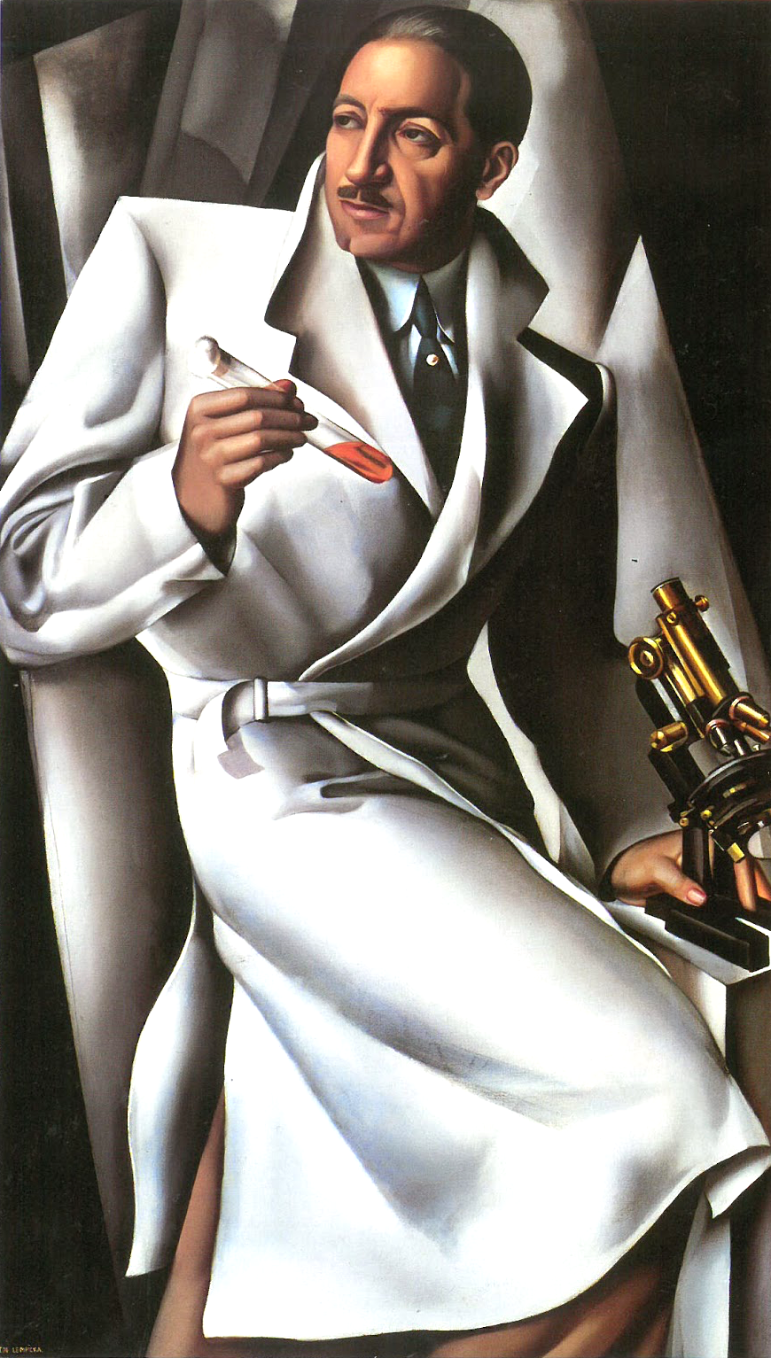
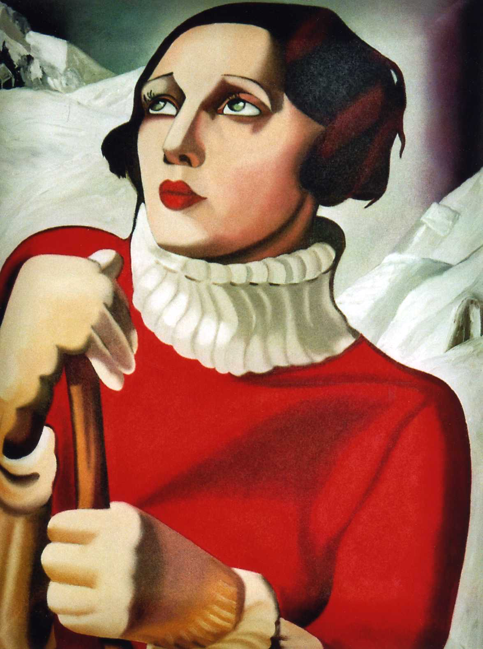
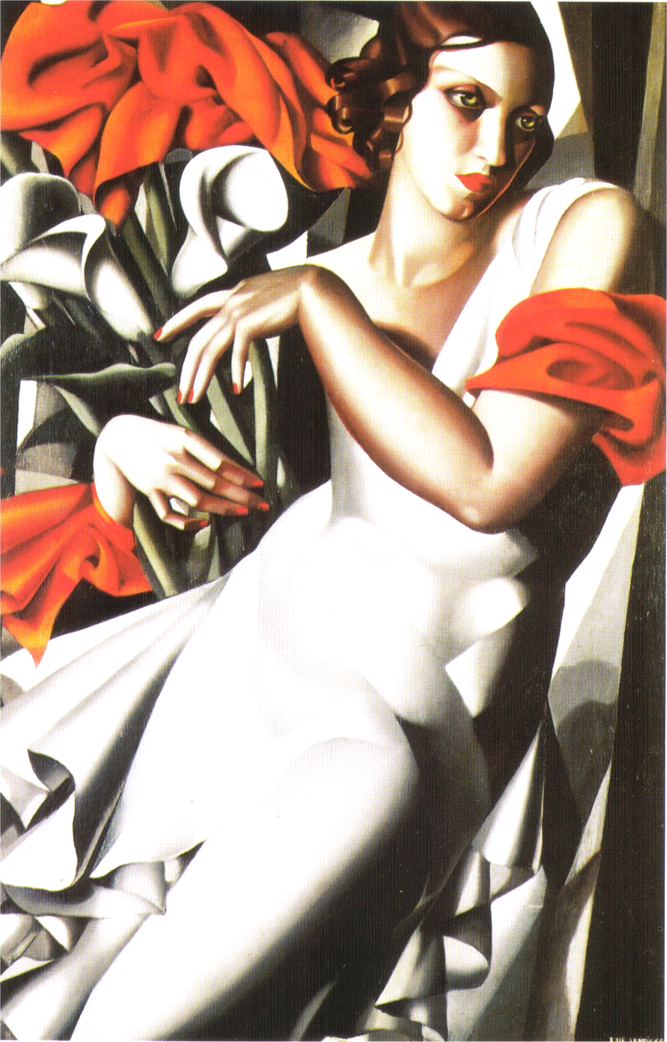
Dr Claire Walsh
TAMARA DE LEMPICKA
MISTRESS OF ART DECO
Tamara de Lempicka dazzled Paris’ artistic circles in the 1920s and 30s and seduced with her stylish portraits. These heady years saw her immortalise the atmosphere of wealth and decadence of Paris. Other painters oscillated between Cubism and Fauvism, but de Lempicka was one of the few to be able to embody the decorative style of Art Deco in her paintings. Stunningly beautiful, she engaged in the world of fashion and photography, as well as presenting herself as the quintessential modern, independent young woman. She was glamorous and notorious, but her extraordinary talent confirmed her reputation as one of the most iconic painters of her generation.
Dr Claire Walsh clairewalshlecturer@gmail.com 01480 830 760 www.clairewalsh.moonfruit.com

Slide 2
Dr Claire Walsh
TAMARA
DE LEMPICKA
MISTRESS OF ART DECO

