Slide 1
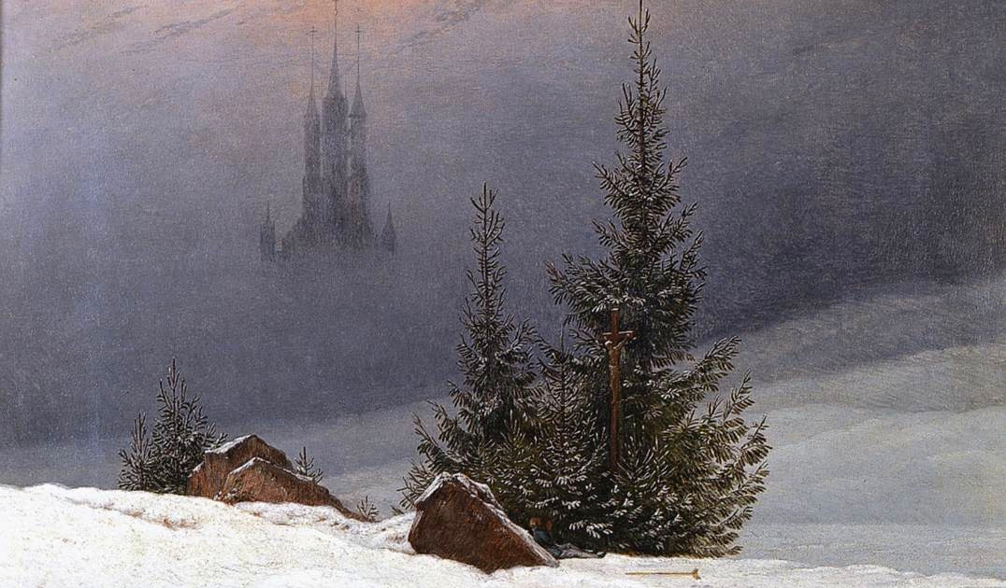
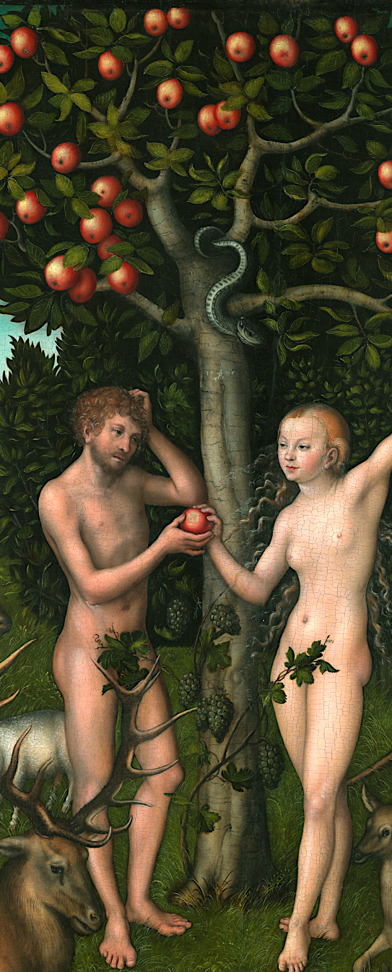
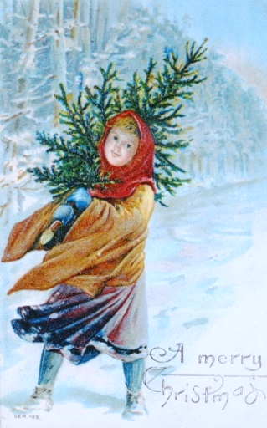
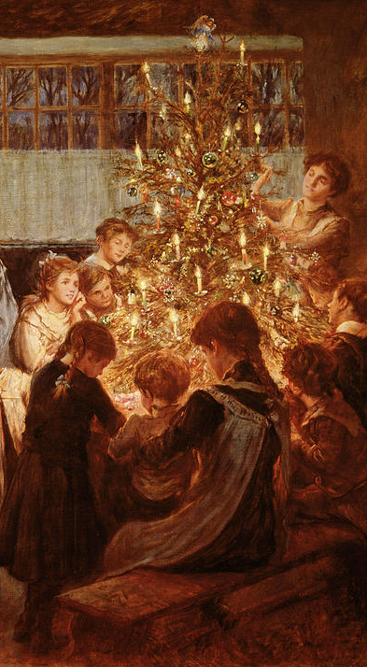
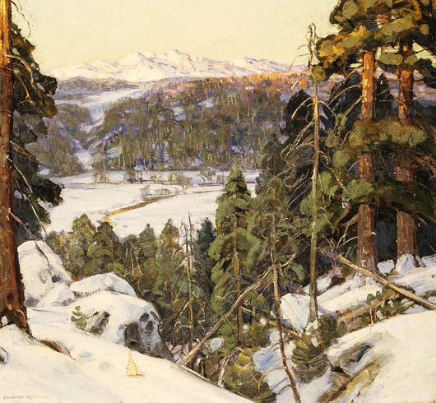
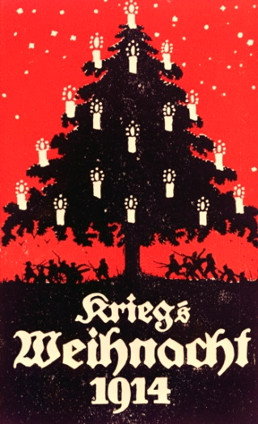
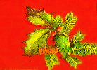
The Christmas Tree
From Forest Fir to Festive Feature
The Christmas Tree presents us with over five centuries of art and meaning. Vital to the imagery of both the pagan world and Christianity, its significance emerged in Norse yuletide, ancient Rome and with the early-medieval saints, before its diverse strands were drawn together to symbolize the modern Christmas. It is wrapped in legend, from the Icelandic sagas to St Boniface, from the Mystery Plays to Martin Luther. In art, the forest fir has made the transition from Viking rock carvings to German Romanticism and Scandinavian naturalism, on its way to finding its place as an icon of our modern festival. Decorated and shimmering with light, it has brought Christmas from outside the home into the heart of the family, it has drawn soldiers together across No-Man’s Land, and it continues to symbolize its essential, timeless message of Peace on Earth.
Dr Claire Walsh 01480 830 760 clairewalshlecturer@gmail.com www.clairewalsh.moonfruit.com

